Slide 1
Learning Collaborative to Address Diabetes Prevention: Marketing the National DPP to Disproportionally Affected Audiences
November 18, 2021
Notes:
Good Afternoon, my name is Maddie brady and I am with the American medical Association. I am thrilled to welcome all of you to a webinar that is part of the Learning Collaborative to Address Diabetes Prevention jointly hosted by the American College of Preventive Medicine, the American Medical Association, and the Black Women’s Health Imperative.

Slide 2
Disclosure
No Disclosures or conflicts of interest from any of the speakers
Notes:
None of the speakers have any disclosures or conflicts of interest

Slide 3
Disclaimer
This presentation is supported by cooperative agreement DP-18-1802, funded by the Centers for Disease Control and Prevention (CDC).
Its contents are solely the responsibility of the authors, and do not necessarily represent the official views of the Centers for Disease Control and Prevention or the Department of the Health and Human Services
Notes:
READ SLIDE
Acknowledge this presentation is supported by a cooperative agreement from CDC & ACPM -

Slide 4
Housekeeping
All attendees are on mute. Please do not put us on hold.
The webinar is being recorded.
If you have any questions, please type them in the Q and A box and we will address them during the Q/A session.
ACPM will email attendees the slides, and the recording of this webinar.
Notes:
A bit of housekeeping
READ SLIDE

Slide 5
About the Project
ACPM has received funding from the Division of Diabetes Translation within the National Center for Chronic Disease Prevention and Health Promotion at the Centers for Disease Control and Prevention (CDC) to address prediabetes in vulnerable populations.
ACPM is collaborating with the American Medical Association (AMA) and the Black Women’s Health Imperative (BWHI) to:
Enhance support for health care organizations to screen, test, and refer high-risk Black and Hispanic women within communities to a CDC-recognized type 2 diabetes prevention program and
Strengthen community support to improve enrollment and retention in this lifestyle change program.
The Learning Collaborative was started to keep health systems, community-based organizations, and stakeholder engaged in diabetes prevention
Notes:
READ SLIDE

Slide 6
Audience Poll
What is your biggest concern when it comes to enrollment?
Please put your answer in the chat

Slide 7
Turning up the Volume on the National DPP
marketing the Lifestyle Change Program to Disproportionately Affected Audiences

Slide 8
What do we know about our audiences
Our audiences live in noisy environments.
They need to be exposed to our messages multiple times.
They need to hear the message from a trusted messenger.
Weight loss may not be their top priority.
They need a personal touch.
They need to find their “why”.
They need to feel like they can be successful.
We need to focus on readiness in addition to awareness.
We have trust issues.
History of not being “heard” by health care providers.
Cultural taboos about disclosing personal information to strangers.
Stigma associated with seeking support services.

Slide 9
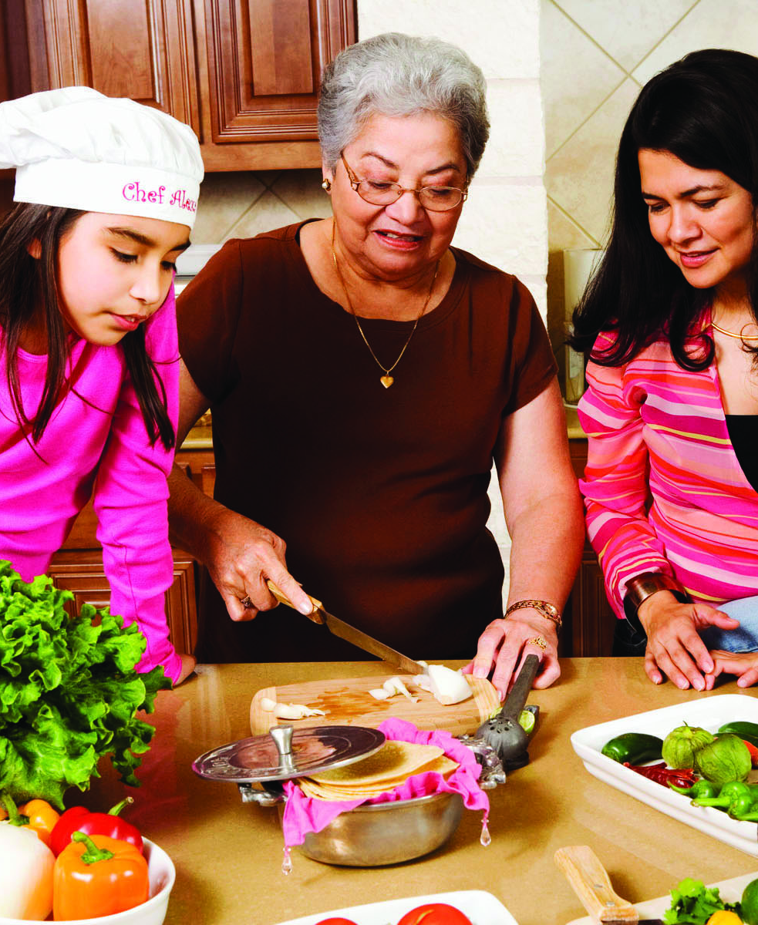
Successful Approaches
Audience driven
Use a mix of in-person, media and public relations
Leverage stories of participants and coaches
Positive messaging that tells a compelling story
Alexis’ advice
Turn up the volume (increase frequency and mix of channels)

Slide 10
Meeting Your Audiences Where they Are
Right partners
Faith communities, worksites, community centers and events
Right channels
Social media, radio, newspapers, outdoor media
Right messages

Slide 11
What do people hear when we talk about the Lifestyle Change Program?
We tend to focus on knowledge and action.
Knowledge doesn’t lead to behavior change.
How do we move people in contemplation and preparation?
We need to address:
Meaningful benefits
Self-efficacy
“Trialability”
Frequency of communication
“There’s a difference between knowing the path and walking the path.”
- Morpehus

Slide 12
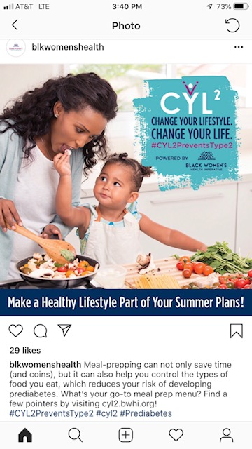
Positive Messaging that Tells a compelling story
Understand your audience.
Don’t forget health care providers and payers are audiences too.
Think about how to build a relationship with them over time.
Identify authentic stories.
Don’t forget to include your key messages and actions.
Everything tells your story.
Visuals, messages, etc.

Slide 13
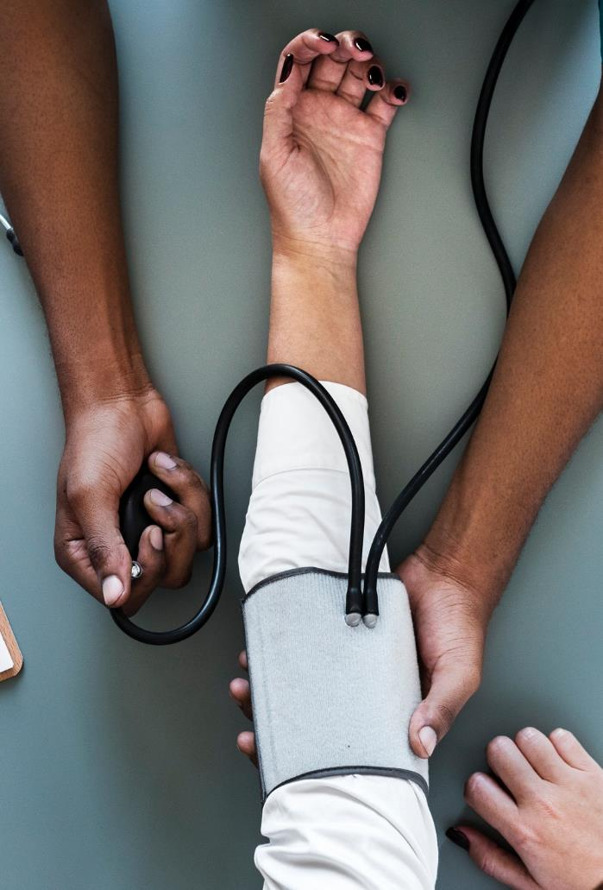
Understand your audience to understand what will move them.
Empowers me to live my best life.
Solves my problems.
Makes me a better doctor/employer.
Engages us with key audiences in long-term, meaningful ways.

Slide 14
public relations, not just advertising
A strategic communication process that relies on building relationships between organizations, partners and the people they are trying to reach in order to motivate them to carry your message.
Build relationships with people, places and organizations that reach your key audiences.
Includes public and private sector partners, and the media.
Use word of mouth strategies and engage “influencers”
Work with champions.

Slide 15
Public Relations
Good use of limited resources
Can cut through the noise
Allows you to tell a story
Enhances credibility
Making it work
Create once, use everywhere.
Make it easy for others to share your story.

Slide 16
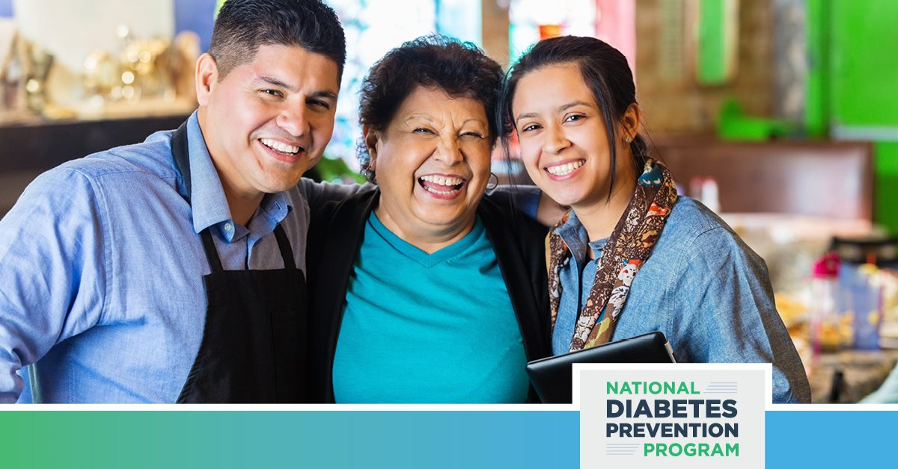
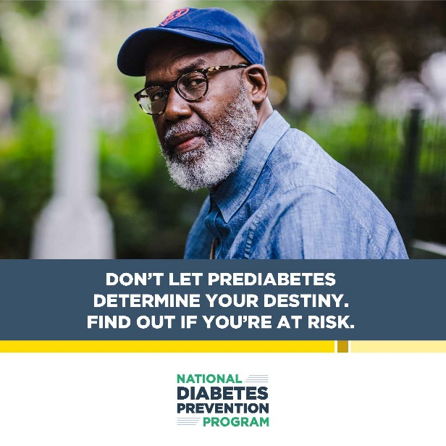
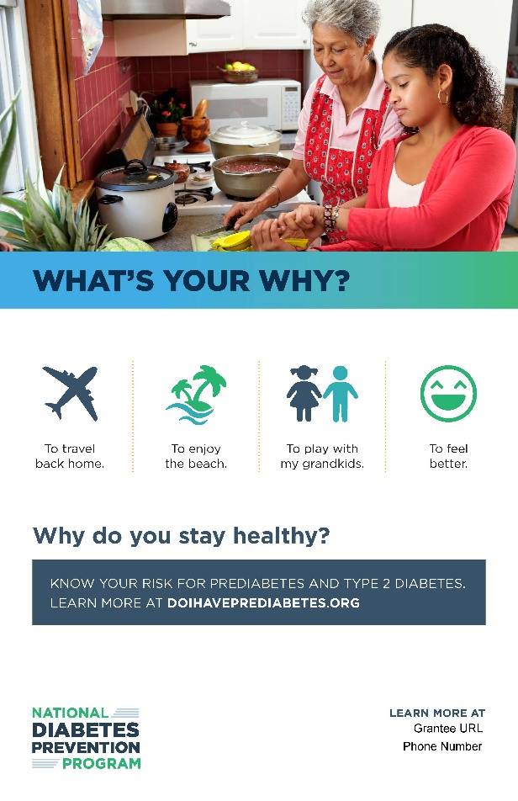
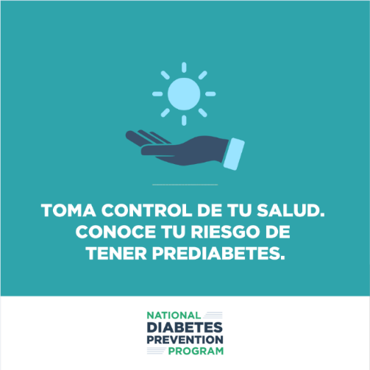
For Example: 1705 Promotional Packages
Promotional packages reflect observances, audiences, and/or themes. Materials that might be included are:
Drop-in Article (Long/Short)
E-blast Copy
Print Ads or Posters
Radio PSA Script
Social Media Posts and Images
Notes:
TALKING POINTS
To support 1705 marketing strategies, CDC has develops sample promotional materials to help you spread the word about the National Diabetes Prevention Program, prediabetes, and the lifestyle change program. Topics range from specific health observances to year-round messages. Each package includes sample copy and images that can help you promote the National DPP and your local lifestyle change program. Some will have a relevant theme – for example Minority Health Month for April, Mother’s Day in May, etc. – and others may be more evergreen. The packages include a variety of communication products, some of which could include drop-in articles, newsletter content, sample social media messages, radio PSAs, newspaper ads, etc. Announcements will go out as new materials are posted.
Here are some suggestions for how you can use them:
Drop-in Article (Long/Short): You can post sample drop-in articles on your organization’s home page as a highlight story, include them in one of your print or online publication(s), post them to the news section of your organization’s website, and/or send them to a local newspaper or magazine. You can use shorter drop-in articles in newsletters, send them out to your email subscription lists, and/or share the articles with other groups and partner organizations.
E-blast Copy: You can distribute e-blasts through an email listserv or a preferred e-blast vendor to your organization’s subscribers and people who have expressed interest in the lifestyle change program.
Print Ads or Posters: Use print ads or posters for placement in a local newspaper, make copies and give them out as flyers, print them and post them on bulletin boards, print and hang posters, make them into self-stand foam boards for counters, and/or place them in sessions.
Radio PSA Script: You can send radio PSA scripts to a local radio station and ask the station manager to have a DJ record them, read them before an event, record them for their telephone system, and/or record them and share the recordings with local pharmacies.
Social Media Posts and Images: You can share sample social media posts and images with your communications or marketing personnel to post on Facebook, Twitter, and Instagram.
The images here are just a sample to give you a sense of what the materials will look like. If you have any questions about the packages, you can contact your CDC Project Officer and the Strategy #3 team (Alexis Williams at afw0@cdc.gov and Chelsea Echavarria at chelsea.echavarria@icfnext.com).

Slide 17
Integrate your efforts
Are you making the most of your promotion opportunities?
Don’t be afraid to repeat yourself.
Create once. Publish everywhere.
Is everyone singing from the same sheet music?
Are your messages for people at risk, providers, insurers/employers driving to the same behavior?
Is messaging consistent across your promotion efforts? How about your website and social media channels?
Are coaches, participants, educators, referrers, the people at the front desk humming the same tune?

Slide 18
Lessons Learned
Your marketing plan is your road map. Plan your work. Work your plan.
Understand your audiences.
Understand how to build a relationship with your audiences over time.
Knowledge + Meaningful benefits + Self-efficacy
Think PR. Think stories.
Turn up your promotions to 11.
Think integration – how do all of your strategies fit together?
Get help.
Internal marketing and PR expertise.
Colleges and universities.
Marketing firms.

Slide 19
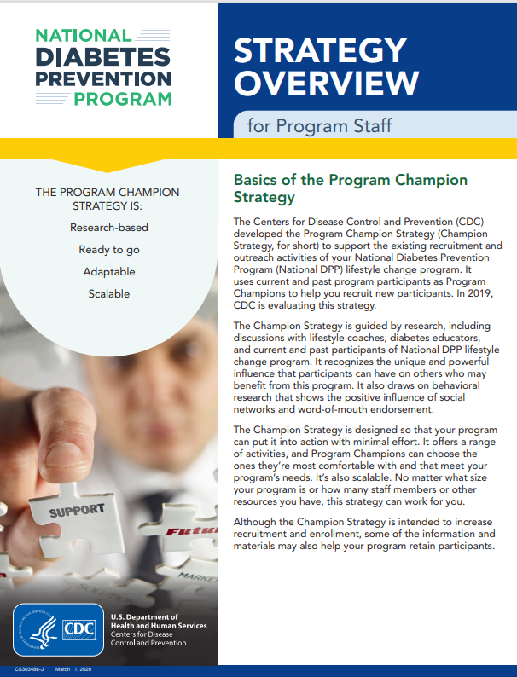
CDC resources
Marketing and Communication Toolkit
https://www.cdc.gov/diabetes/programs/stateandlocal/marketing.html
National Diabetes Prevention Program Resources
https://www.cdc.gov/diabetes/prevention/index.html
Path2Prevention
Visit the Customer Service Center for more information
https://diabetespath2prevention.cdc.gov/
Program Champion Strategy Toolkit
Visit the Customer Service Center for more information

Slide 20
Alexis Williams, MPH, MS, MCHES, Health education and Promotion Team
awilliams15@cdc.gov

Slide 21
Audience Poll
Poll Question:
How often do you change your marketing materials?

Slide 22
Black Women’s Health Imperative
Travis Parker
Principal, Peter Parker Creative
Programs Communications Consultant, BWHI

Slide 23
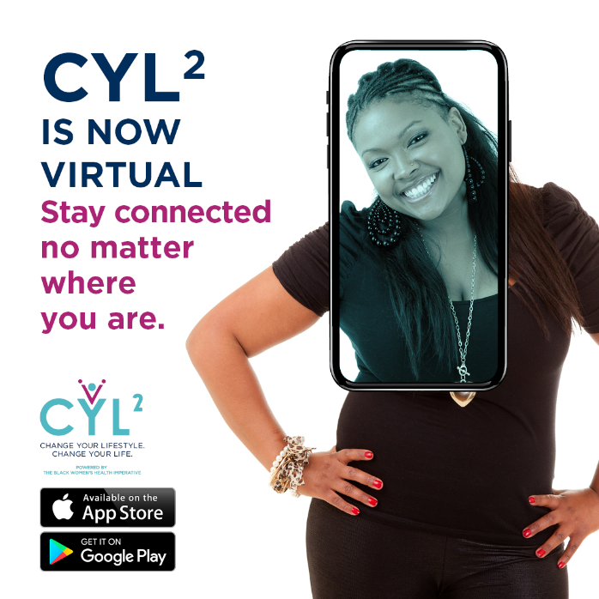
Diabetes Prevention Goes Virtual
Curriculum Culturally Tailored for Black Women by Black Women
AARP Partnership – Virtual Events Targeting 4 Cities
Digital App – The BWHI App
Introduce the BWHI App and Invite to Enroll
Notes:
BWHI became an approved distance learning provider last year, and we also received approval on our curriculum which was culturally tailored for Black women. One of the other big milestones that we achieved was the development of our BWHI App. It is a culmination of several different resources, including virtual classes and public communities in which we share health and wellness content. I will share more about the features shortly. In partnership with AARP, we identified two rural cities and two urban cities where we hosted virtual events to introduce the BWHI App, the CYL² virtual classes and enroll eligible participants. Those cities were Tuscaloosa, AL; Natchitoches, LA; Detroit, MI, and Atlanta, GA. While we only expected to enroll participants from these selected cities, we received responses from all over the world and made the decision to open enrollment to anyone who was eligible.
Our lifestyle coaches are able to facilitate the CYL² classes directly within the App itself. We have already begun piloting these yearlong classes within the App and will be starting a few new classes in January 2021.

Slide 24
Culturally Tailored Curriculum
Priority Populations: Black Women and Latinas
Feedback from Existing Participants and Coaches
Responses from Virtual Events
Research
Additional Content: Aging, Chronic Stress, Self-Care, Financial Wellness
The Approval Process
Notes:
With Black Women and Latinas being the priority populations for the Black Women’s Health Imperative, it is important that we offer content that is culturally relevant.
In order to design a curriculum for Black women, we wanted it to be developed by Black women. So, we obtained feedback from existing participants, lifestyle coaches, and responses from virtual event attendees. Our research led us to creating additional content around emotional wellness, financial wellness, and self-care. Our lifestyle coaches can now facilitate conversations around topics such as Chronic Stress, Intersectionality, and Lived Experience; Practicing Self-Care for Life; Aging Like a Fine Wine (which includes content about hormonal changes and impact on your health and weight); and What's Money Got to Do with It? when it comes to discovering and maintaining financial wellness.
The curriculum went through an extensive review and approval process by CDC prior to delivering the content to participants.
We are currently following the same process for tailoring the curriculum for the Latinx population and general population.

Slide 25
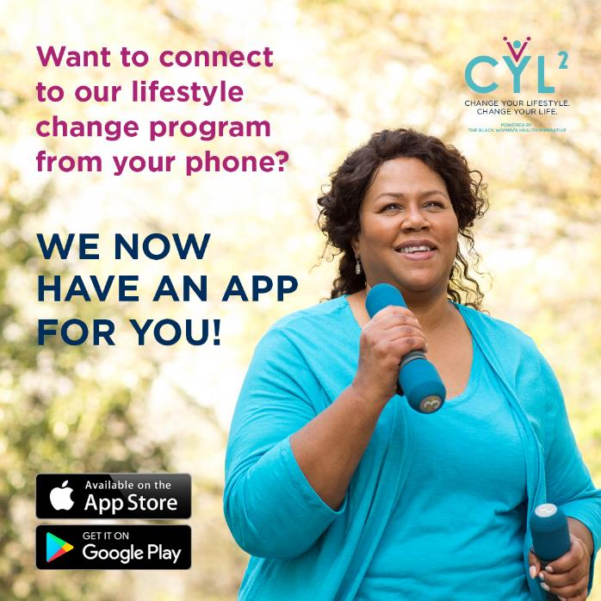
BWHI App Features
Virtual CYL² Classes
Public Communities
Live Events
Health and Wellness Content
Notes:
In addition to virtual CYL² classes led by live lifestyle coaches, the BWHI App offers public communities that function as communication hubs available to the public. A person does not have to be enrolled in a CYL² program to join any of the public communities. There is also an option to create and manage private communities in those cases where we need to allow access to specific members. In all, public and private communities are great ways to discuss health and wellness, offer support, and have access to content about nutrition, stress, self-care, and many other topics.

Slide 26
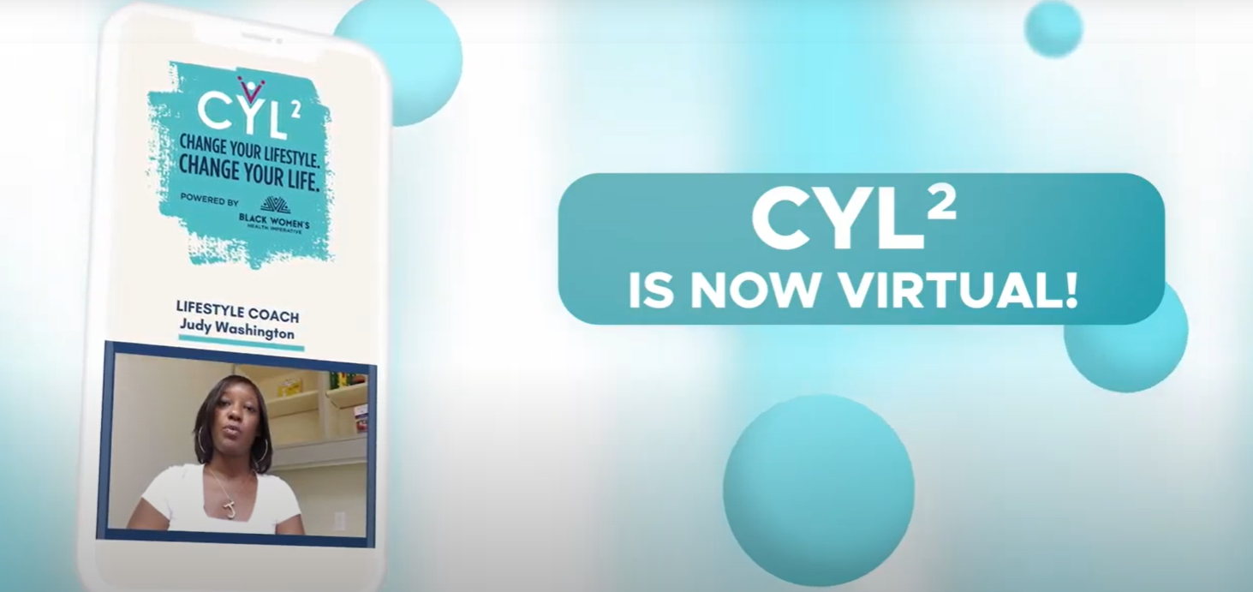
Marketing Efforts
Notes:
Now I’m going to show you some of the communications we’ve doe to promote these initiatives.
First, I’d like to play you a video that we put together to showcase the app experience.
[Play video]

Slide 27
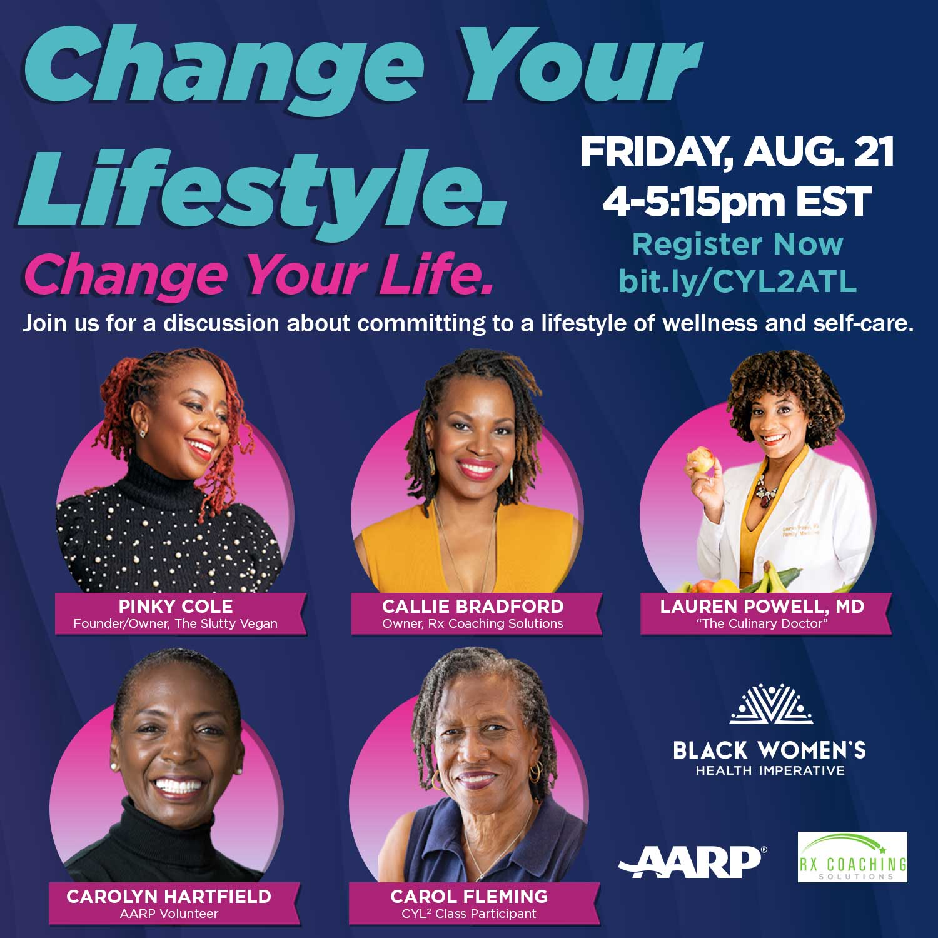
Marketing Efforts
Partnership with AARP
Atlanta, GA; Detroit, MI, Natchitoches, LA; Tuscaloosa, AL
Live webinars and panel discussions
Combined marketing efforts of BWHI + Partners
Social Media
Eblasts
Notes:
The video was used to build awareness of and interest in the app before it was released to Google and Apple app stores. We also showcased the video during the AARP live virtual events, and some of our program partners have shown the video during their virtual events as well.
As was previously mentioned, we the AARP live events targeted residents in Atlanta, GA, Detroit, MI, Natchitoches, LA, and Tuscaloosa, AL. To promote these events, we developed a series of graphics – like the one pictured –The cards promoted an opportunity to join us for a discussion about committing to a lifestyle of wellness and self-care, as research has shown people are more open to the ideas of wellness and self-care than diabetes prevention. After all, if I don’t think I have diabetes or if I don’t want to believe I’m at risk, my brain is more likely to tune out the message. Meanwhile, terms like “wellness” and “self-care” sound warm and inviting.
In addition to the general messaging, we featured members of the panel, with different panels for each city based on speakers relevant to that region, including local news and online personalities.
We created social media campaigns with the materials on Facebook, Twitter, and Instagram. We also sent eblasts to our email list and worked with partners in these pilot cities to assist in getting the word out through their networks.
Tens of thousands of people saw the ads and many clicked our promotional links to visit our landing pages and to register for the events.

Slide 28
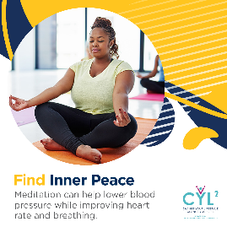
Supporting Partners
Campaign materials
Flyers
Email graphics
Social media (app promos, healthy habits, testimonials, headers, one year of posts)
Press releases
Radio scripts
Notes:
Beyond the virtual events we just discussed, we wanted to ensure our program partners and cohorts had a fresh supply of marketing materials they could take and use in their markets to promote their programs. This led to the creation of a new campaign including flyers, email graphics, press release templates, radio scripts, one full year of social media posts including photos and videos, and more digital and social content like graphics promoting healthy habits, such as the “Find Inner Peace” graphic in the top right. This graphic is one of many that suggests a healthy habit and offers reasons why it’s valuable.
Other graphics focus on language like, “Are you ready to change your life?” and “Change Your Lifestyle Today for a Healthier Tomorrow”. What we’re doing here is advertising the benefit of the program, not the goal. We COULD say join our diabetes prevention program, but that doesn’t offer a reason. So instead, we’re putting the benefit first and letting it do the talking.

Slide 29
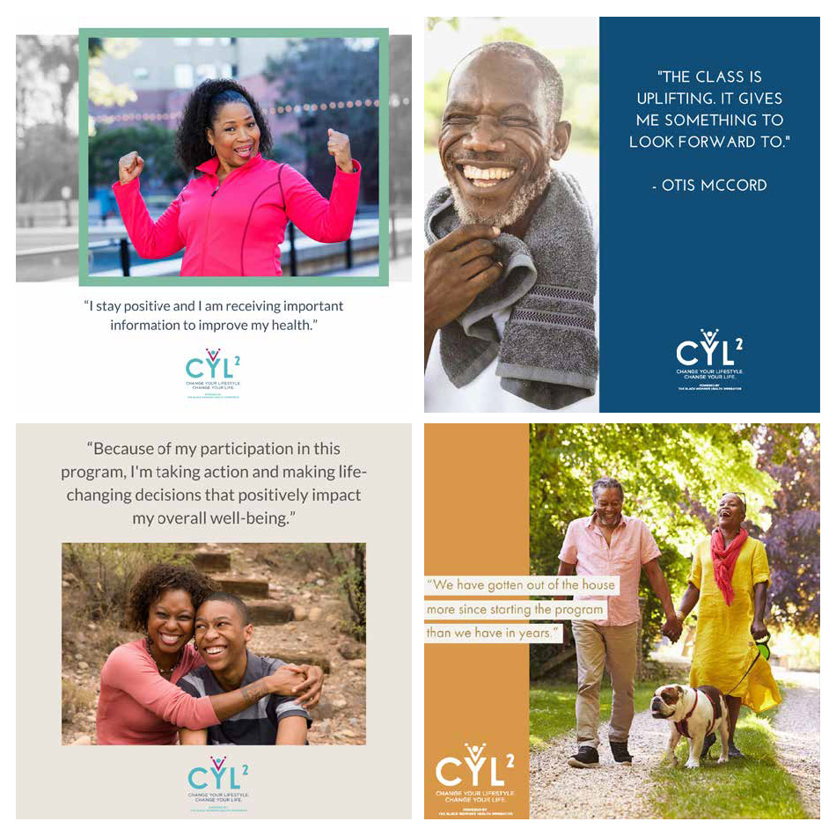
Social Media Graphics

Slide 30
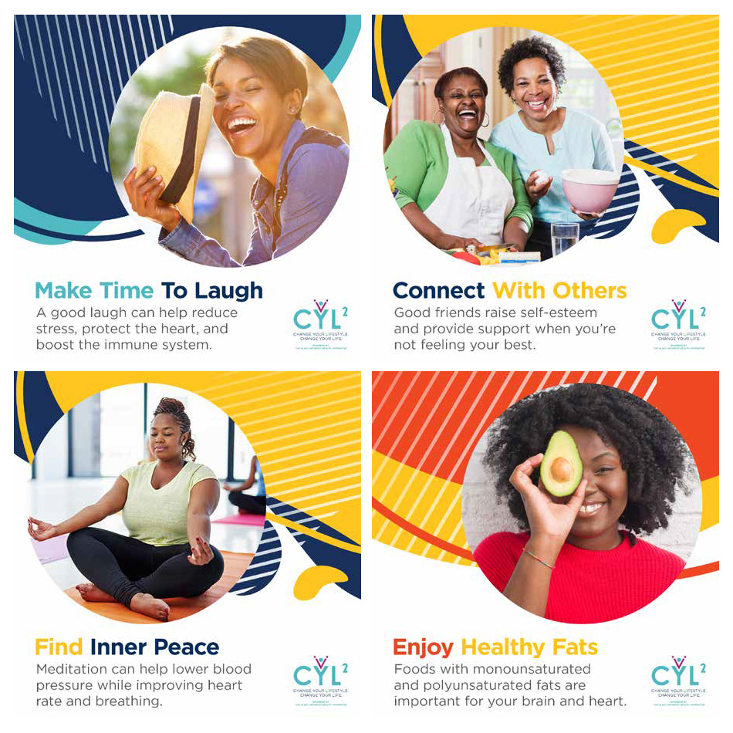
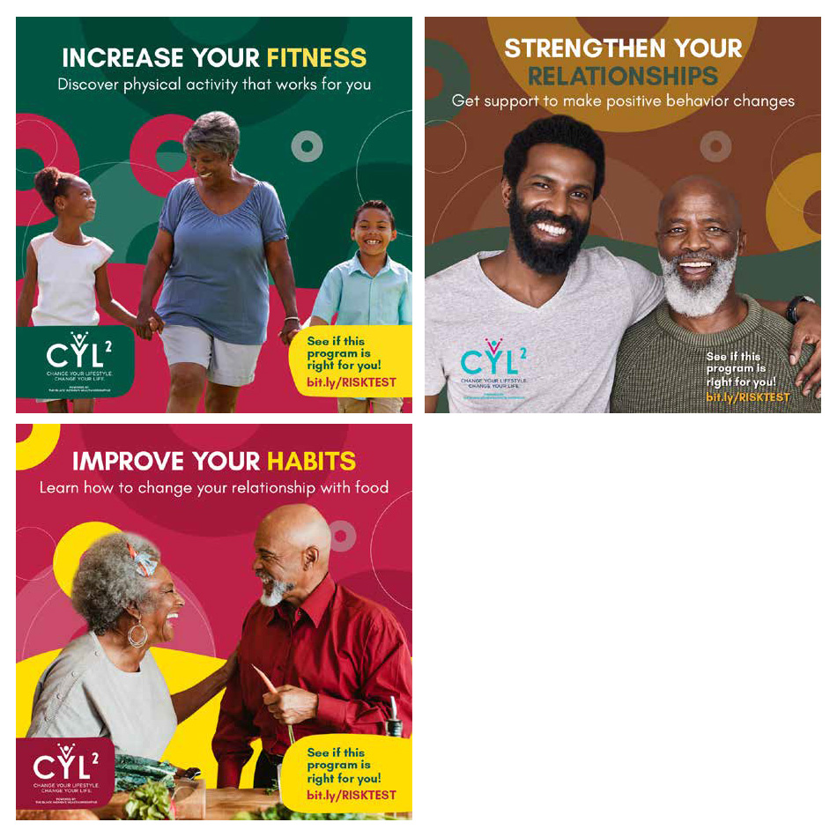
Social Media Graphics

Slide 31
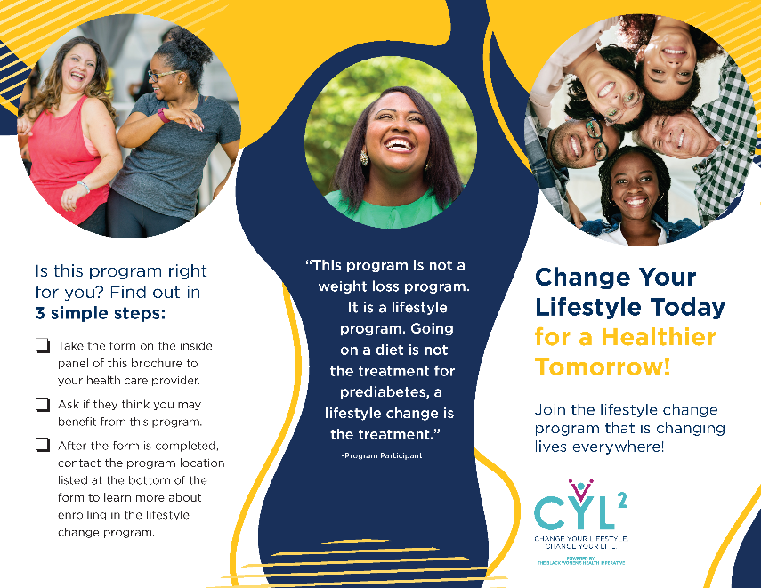
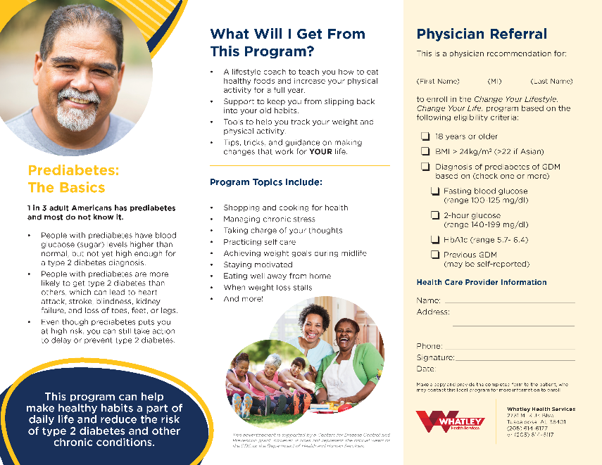
HCP Referral Brochure

Slide 32
Partner Communications TA
Communications
Survey for SWOT analysis
1-on-1 support
Best practices guides
Virtual Program
Onboarding
Experience surveys
Open door policy for all needs
Notes:
What we just covered involved creating and disseminating resources to our program partners so that they had the materials they needed to get the word out without very little effort. But we would never just hand off materials and wish people luck! No, we are continuing touch bases and additional support to help minimize and roadblocks and maximize program enrollment.
In communications, we’re accomplishing this by offering communications technical assistance to each cohort in different ways. First, we sent a survey with key questions to see where each partner stood in terms of communications capabilities, efforts, and experiences to date. We followed that up with one-on-one support meetings to discuss best practices and opportunities specific to the partner. We’ve also disseminated best practices guides and notes to the group as a whole.
Regarding the app experience, we developed an onboarding procedure for lifestyle coaches, as well as experience surveys so that she can get weekly feedback on any technical issues as we pilot test the app.
The overall arching theme is that we are working to be a resource for partners and we’re working to ensure we have an open door policy so we can always hear and assist with overcoming challenges and celebrating milestones. After all, the best way for us to ensure the app, program enrollment, and the betterment of health in our communities moves in the right direction, is by all of us working together.

Slide 33
Thank You!
For more information:
CYL2@bwhi.org
BWHI.org/cyl2

Slide 34
Questions?
Notes:
None of the speakers have any disclosures or conflicts of interest

Slide 35
Additional Resources:
ACPM: https://www.acpm.org/initiatives/diabetes-prevention/
BWHI: https://bwhi.org/change-your-lifestyle-cyl2/
AMA: https://amapreventdiabetes.org/

